Slide 1
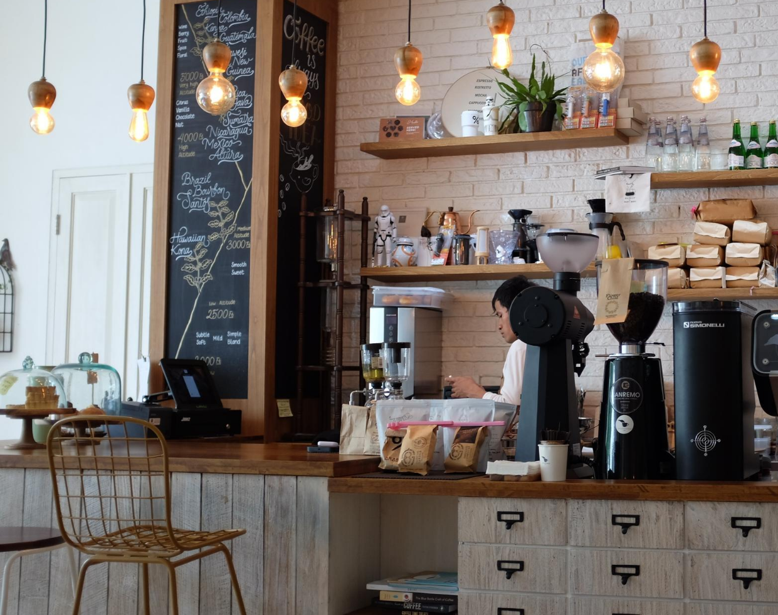
Café Coffee Night
Retail and Marketing Analysis Project
Aarushi Verma

Slide 2
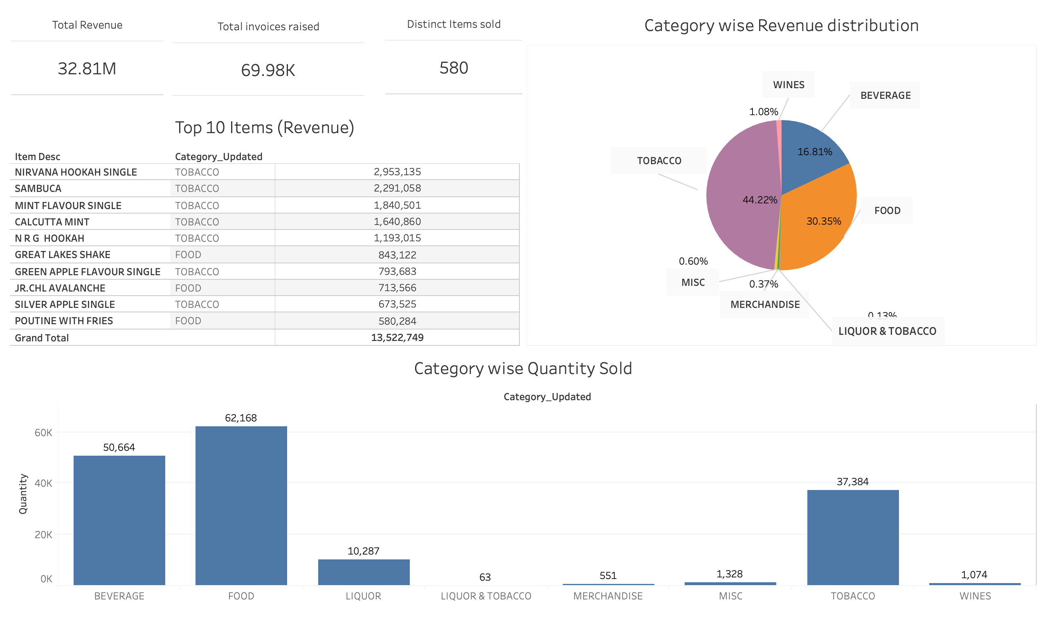
Executive Summary
The total revenue for the period April 2010 to March 2011 was 32.81 Million wherein ~70K invoices were raised and 580 unique items were sold.
In terms of revenue the highest selling category is Tobacco (44.2%) followed by Food (30.35%)
In terms of Quantity the highest selling category is Food, followed by Beverages
The top 10 selling items in terms of revenue belong to the Tobacco and Food category

Slide 3
Exploratory Analysis
We reviewed the POS data for the Café Chain and noted the following:
The data contained 145830 rows and 10 columns (Date, Bill No., Item, Time, Qty, Rate, Tax, Discount, Total and Category
The data contained 3 string columns, 4 numerical columns, 1 Date and Time and 1 Time column
We also noted that same items were categorized into different categories and same was rectified before performing the analysis

Slide 4
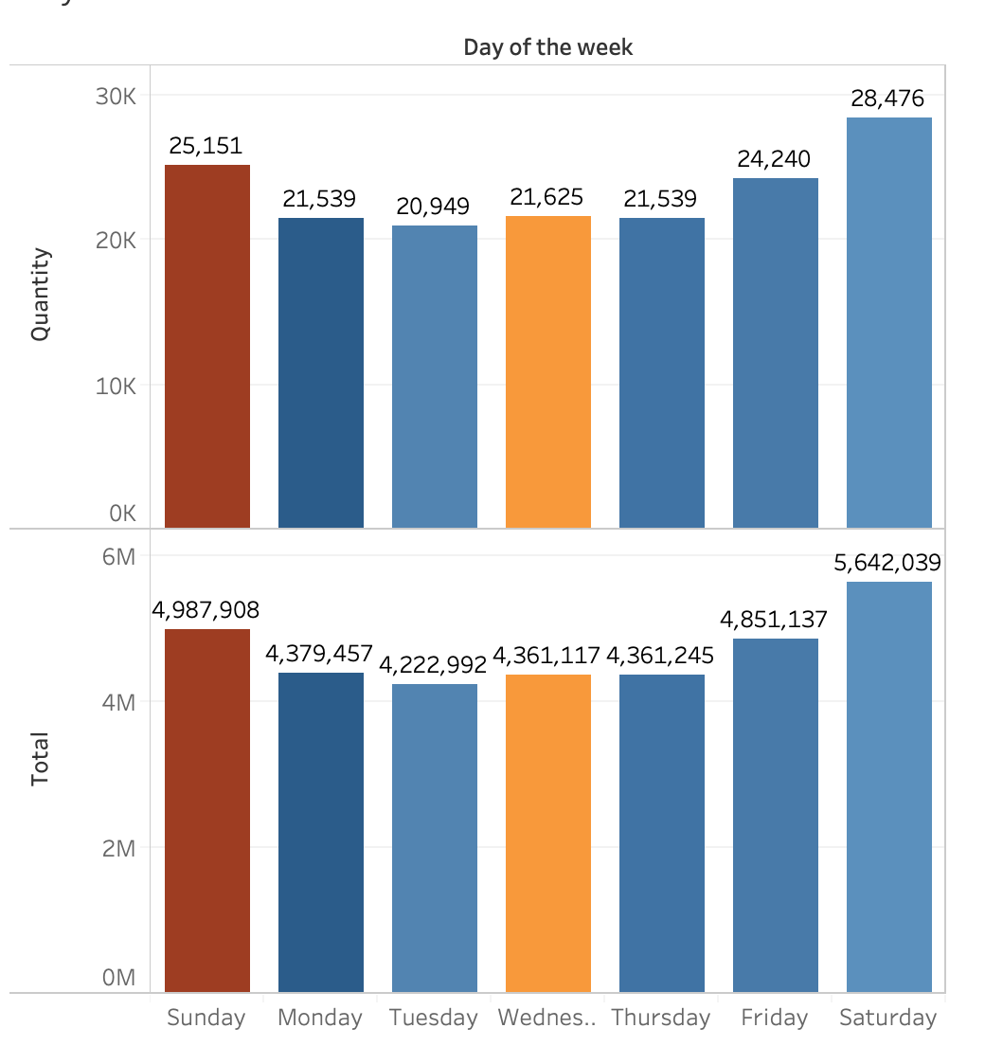
Consumer Behaviour – Day of the week
On analysis of consumer behaviour across days of the week we noted the following:
Highest sales are on the weekend (Saturday and Sunday) – Value of 5.6 M on Saturday and 4.9M on Sunday.
We also compared the average discount given on each day and noted that:
- Greatest Average discount is offered on Sundays followed by Wednesdays
Based on this Consumer Behaviour we can recommend that the Café should offer different types of schemes, such as happy hours to increase their sales on Weekdays in comparison to Weekends
Discounts on Sunday can be reduced in order to increase sales as the crowd will be attracted either way as it is a weekend

Slide 5
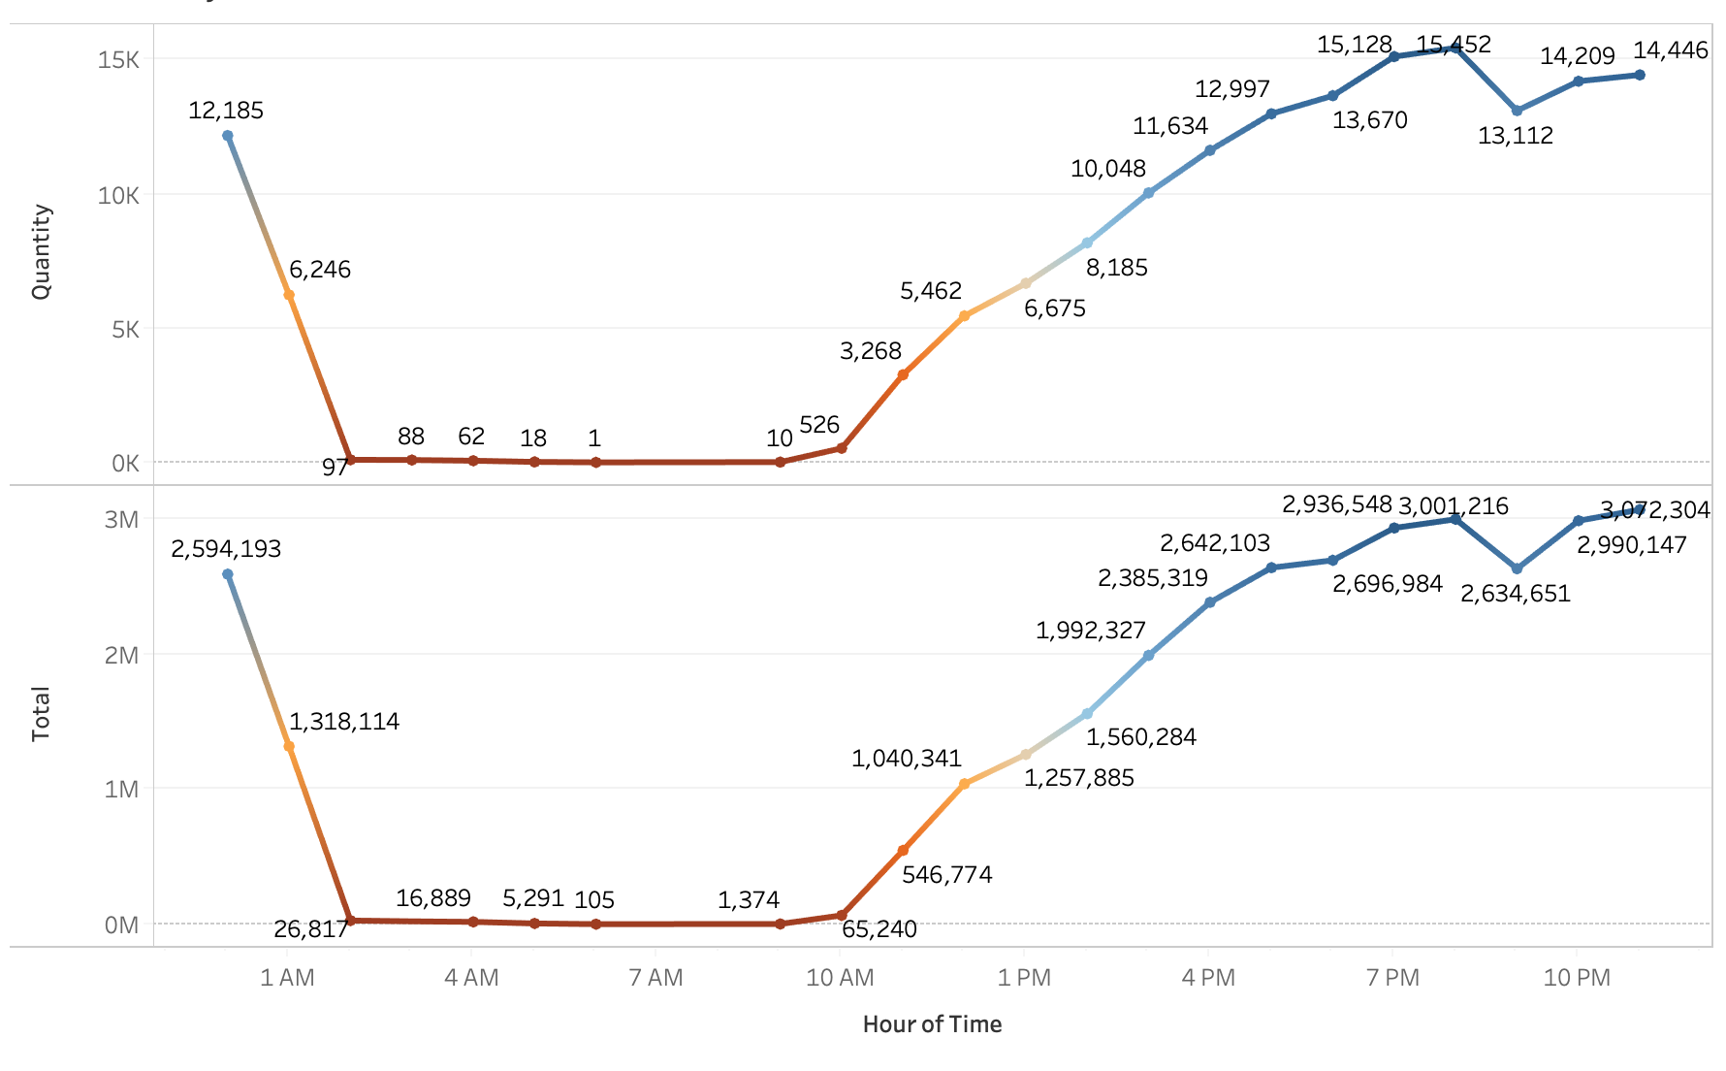
Consumer Behaviour – Time of the day
On analysis of consumer behaviour across time of the day we noted the following:
Sales start around 9 AM in the mornings, with very low invoice generation
The highest number of invoices generated and movement in the cafe is during the later part of the day between 4 PM and 9 PM
There seems to be a fall in the sales around 9 PM
Invoices are also generated post 12 AM till 6AM in the morning. However this is extremely low
Action should be taken in order to identify why there is a fall in sales at 9 PM. This could be due to peak at 8 PM and seats not being available. However in that case the restaurant should work on their turn around time in order to accommodate maximum customers as this should ideally be the peak time for the Cafe
As there is barely any movement at the Café at night, it could be considered to shutdown café at night to save on costs such as electricity and overtime wages. An alternative would be to market to customers in the area as well through social media in order to let customers know that the café is open 24 hours and probably provide delivery services in order to increase sales

Slide 6
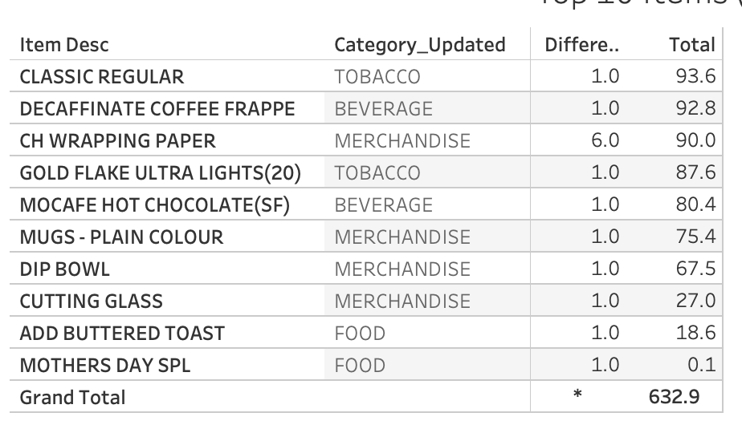
Menu updates
With the help of the date of invoice, we calculated the number of days a product was sold on the menu. Using the minimum invoice date and maximum invoice date and taking the difference we got the days the item was sold during the review period
We then identified the least sold items on the menu in terms of revenue and noted that the bottom 10 were products which were on the menu for less than 7 days.
These items should be removed from the Menu as they could be mispunched while generating invoice leading to further return and credit note issues.
Further, we also identified products which generated very less sales during the review period. Kindly refer appendix for the same

Slide 7
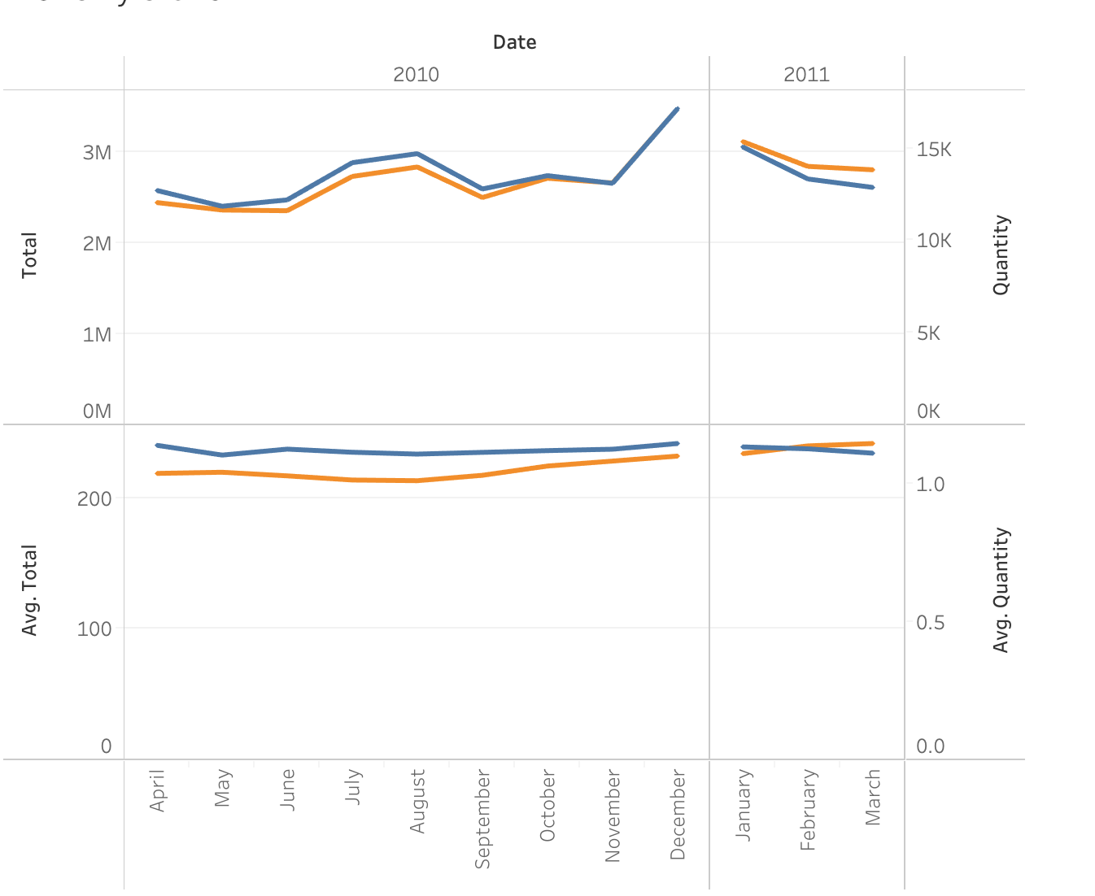
Monthly Trends
On plotting the sales and quantity across months we can see the trend that there is a rise in sales towards the end of the year starting in November which continues to January followed by a fall
However when we look at the average sales and quantity both seem to be constant across the year
This implies that this branch is performing consistently, and we can leverage this to further increase revenue

Slide 8
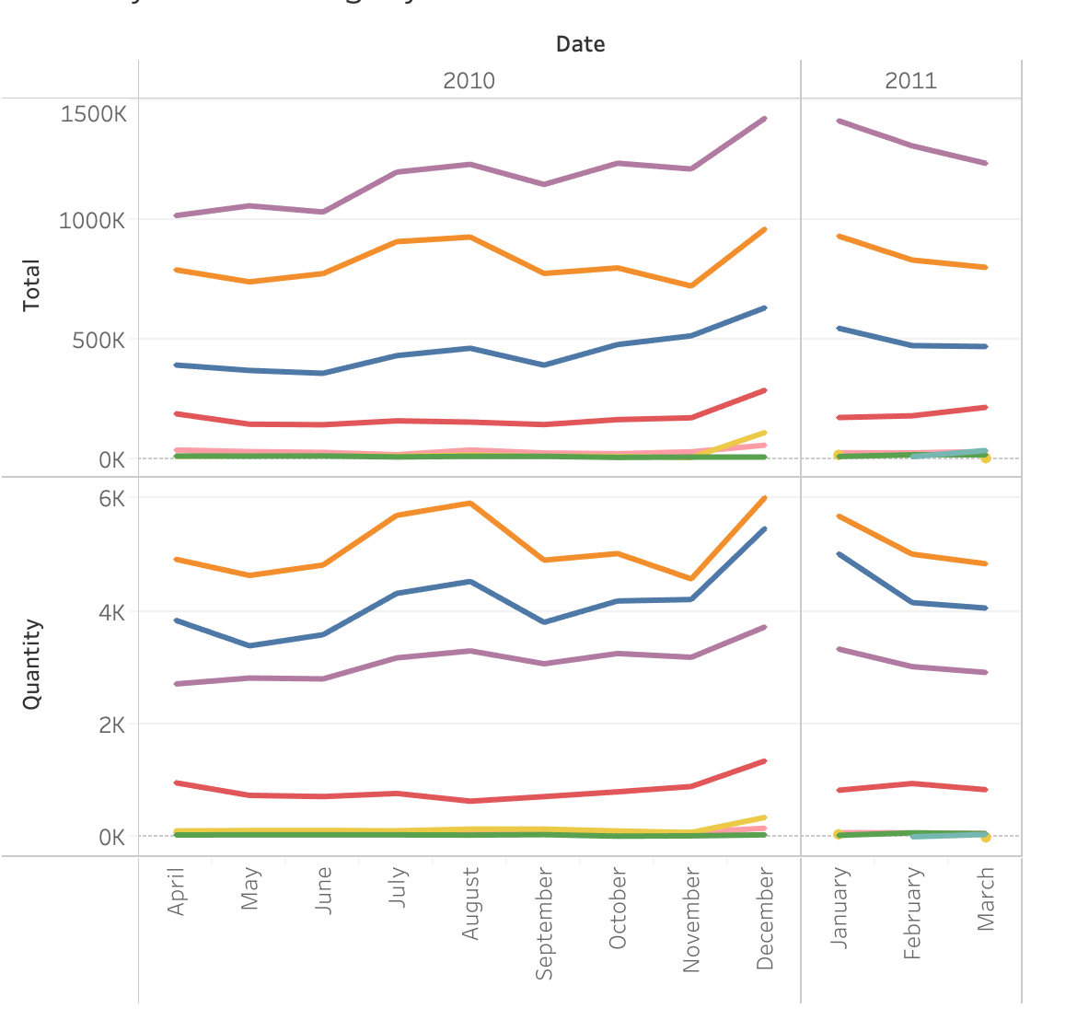
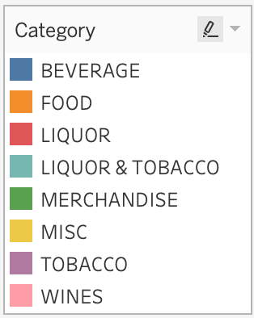
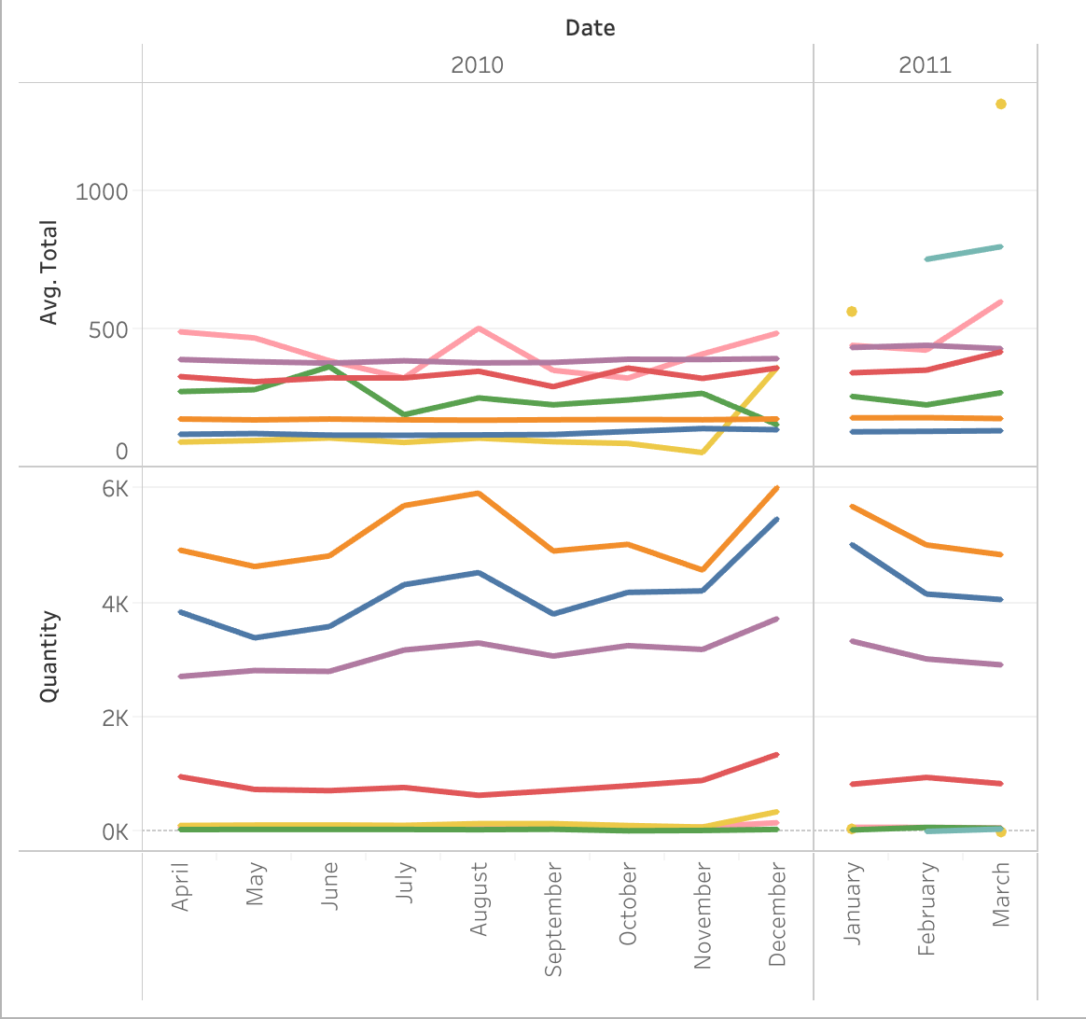
Monthly Trend Category Wise
Through the category wise monthly trend we can observe that tobacco generates the highest sales and follows the same trend as the overall sales.
All categories seems to follow suit, except Liqour where we see a fall in sales in January
We can also observe that the Liquor and Tobacco category was only introduced in February
Through the category wise monthly trend of Average sales and Quantity we can observe that tobacco food and Beverage have constant average sales across month with Tobacco slightly increasing. For all other categories we see peaks and troughs which could be due to various exterior factors based on Trends, Consumer likes, seasonality

Slide 9
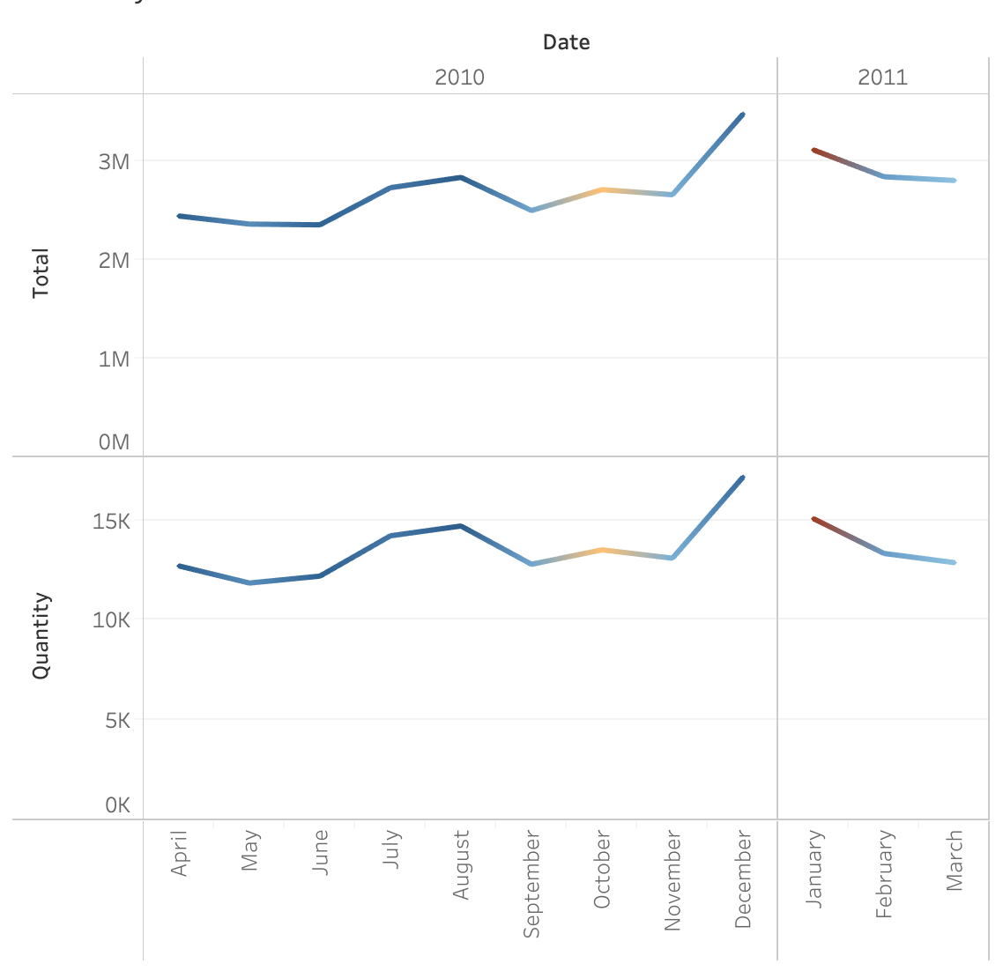
Monthly trend vs Discount
In order to assess the monthly trends, we also plotted the average discount across months and noted that highest discounts were given during the month of January followed by October.
This could be due to an offer running during October or Stock clearing for the previous year in January. However the higher discount in January has not impacted over all sales and therefore it is not an area of concern.

Slide 10
Menu Analysis
Approach
To analyse the menu we will use market basket analysis
We will do this in two stages:
1.) Assess the most common occurring menu items in a customer’s order and recommend combos
2.) Assess the products in Food and Beverage category to recommend suitable meal Combos that can be offered by the Restaurant

Slide 11
Methodology
We have performed the market basket analysis using KNIME with the help of the Association Rule Learner node.
We first imported the data in KNIME, performed an exploratory analysis of the data to make sure there are no missing values or oddities in the data that would hamper the analysis.
Further with the help of the invoices we grouped the data to aggregate the items bought and further applied the association rules with Support and Confidence values to arrive at rules which would highlight the combinations that people tend to buy the products in the store. We then assess the best rules on the basis of the LIFT value
This method helps to identify the items which have close affinity to each other even if they fall in different categories. These insights can further be leveraged to increase sales

Slide 12
Popular Combos
We entered support value of 0.001 and Minimum confidence of 0.1, we received a total of 53 association rules. (The support value is the probability of how frequently the item appears in the data and confidence is the probability our rules are found to be true in the dataset)
Using the lift metric we identified combos that could be sold to the customer (The lift summarizes the strength of association between the products, the greater the value of lift the greater is the link between the two products.
We shortlisted 23 rules out of the 53 which could be used as Combos*
* Due to the presence of the Misc category all rules were not feasible. Food and beverage combos have been computed separately

Slide 13
Popular Combos
Support | Confidence | Lift | Recommended Item | Item Bought | Combo Category
0.001 | 0.412 | 5.924 | GREAT LAKES SHAKE | [VANILLA ICECREAM] | Dessert
0.001 | 0.181 | 5.780 | LEMON ICED TEA | [BLACK CURRANT ICED TEA] | Beverages
0.002 | 0.143 | 4.911 | BERRY BLAST | [COOL CALIFORNICA] | Beverages
0.002 | 0.103 | 4.294 | KIT KAT SHAKE | [THE FERROR ROCHER SHAKE] | Dessert
0.004 | 0.249 | 3.932 | SAMBUCA | [RED BULL 2+1] | Beverage+ Tobacco
0.003 | 0.199 | 3.143 | SAMBUCA | [MAGGI NDL ARRABIATA] | Food + Tobacco
0.002 | 0.142 | 3.010 | CALCUTTA MINT | [RED BULL 2+1] | Beverage+ Tobacco
0.004 | 0.152 | 2.407 | SAMBUCA | [RED BULL ENERGY DRINK] | Beverage+ Tobacco
0.003 | 0.107 | 2.264 | CALCUTTA MINT | [RED BULL ENERGY DRINK] | Beverage+ Tobacco
0.001 | 0.166 | 2.125 | CAPPUCCINO | [ESPRESSO] | Beverages
0.005 | 0.126 | 1.992 | SAMBUCA | [B.M.T. PANINI] | Food + Tobacco
0.001 | 0.149 | 1.905 | CAPPUCCINO | [DOPPIO] | Beverages
0.004 | 0.142 | 1.814 | CAPPUCCINO | [CAFFE LATTE] | Beverages
0.003 | 0.185 | 1.544 | NIRVANA HOOKAH SINGLE | [RED BULL 2+1] | Beverage+ Tobacco
0.005 | 0.184 | 1.534 | NIRVANA HOOKAH SINGLE | [RED BULL ENERGY DRINK] | Beverage+ Tobacco
0.004 | 0.112 | 1.438 | CAPPUCCINO | [MASALA CHAI CUTTING] | Beverages
0.001 | 0.112 | 1.435 | CAPPUCCINO | [THE CHOCO LATTE] | Beverages
0.002 | 0.103 | 1.317 | CAPPUCCINO | [ULTIMATE HOT CHOCOLATE] | Beverages
0.001 | 0.133 | 1.111 | NIRVANA HOOKAH SINGLE | [MEZE PLATTER] | Food + Tobacco
0.006 | 0.130 | 1.082 | NIRVANA HOOKAH SINGLE | [POUTINE WITH FRIES] | Food + Tobacco
0.005 | 0.124 | 1.031 | NIRVANA HOOKAH SINGLE | [B.M.T. PANINI] | Food + Tobacco
0.002 | 0.122 | 1.021 | NIRVANA HOOKAH SINGLE | [MAGGI NDLCREAM/ CHEE/GARLIC] | Food + Tobacco
0.004 | 0.117 | 0.980 | NIRVANA HOOKAH SINGLE | [MOROCCAN MINT TEA] | Beverage+ Tobacco

Slide 14
Meal Combos (Food and Beverage)
We filtered the data for categories and Food and Beverage in order to check association rules for only these two categories. We entered support value of 0.001 and Minimum confidence of 0.09, we received a total of 68 association rules.
Using the lift metric we identified combos that could be sold to the customer (The lift summarizes the strength of association between the products, the greater the value of lift the greater is the link between the two products.
We shortlisted 40 rules out of the 68 which could be used as Combos which comprises of Food+Food, Beverage+Beverage and Food+Beverage Combos*
* Due to the presence of the Misc category all rules were not feasible. Food and beverage combos have been computed separately

Slide 15
Meal Combos (Food and Beverage)
Support | Confidence | Lift | Recommended Item | Bought Item | Combo Category
0.001 | 0.46 | 68.97 | KHEEMA GHOTALA | [BUTTERED TOASTS] | Food+Food
0.001 | 0.19 | 7.47 | GARDEN FRESH PANINI | [FRENCH FRIES] | Food+Food
0.001 | 0.27 | 4.84 | B.M.T. PANINI | [FRENCH FRIES] | Food+Food
0.002 | 0.19 | 3.96 | MASALA CHAI CUTTING | [BUN MASKA & CHAI] | Food+Food
0.001 | 0.10 | 3.49 | COUNTRY ROAST CHICKEN PANINI | [CHICKEN SALAMI PANINI] | Food+Food
0.003 | 0.15 | 2.77 | B.M.T. PANINI | [MAGGI NDL ARRABIATA] | Food+Food
0.001 | 0.11 | 2.71 | OREO COOKIE SHAKE | [LINDT CHOCOLATE SHAKE] | Bevrage+Beverage
0.001 | 0.19 | 2.64 | QUA MINERAL WATER(1000ML) | [CHAI LATTE] | Bevrage+Beverage
0.001 | 0.18 | 2.50 | QUA MINERAL WATER(1000ML) | [SCRAMBLED EGGS] | Food + Beverage
0.001 | 0.11 | 2.49 | BERRY BLAST | [TROPICAL SMOOTHIE] | Bevrage+Beverage
0.001 | 0.11 | 2.45 | BERRY BLAST | [CURRANT COOLER] | Bevrage+Beverage
0.001 | 0.09 | 2.16 | OREO COOKIE SHAKE | [SNICKER BAR SHAKE] | Bevrage+Beverage
0.001 | 0.15 | 2.10 | QUA MINERAL WATER(1000ML) | [SPANISH OMELETTE BREAKFAST] | Food + Beverage
0.002 | 0.13 | 1.87 | POUTINE WITH FRIES | [VEG. CLUB WRAP] | Food+Food
0.002 | 0.13 | 1.85 | QUA MINERAL WATER(1000ML) | [MEZE PLATTER] | Food + Beverage
0.004 | 0.10 | 1.79 | B.M.T. PANINI | [PHILLYCREAM CHEESE &CHILLY PAN] | Food+Food
0.001 | 0.18 | 1.59 | CAPPUCCINO | [CHUNKY CHOCO CHIP COOKIES] | Food + Beverage
0.004 | 0.11 | 1.51 | POUTINE WITH FRIES | [PHILLYCREAM CHEESE &CHILLY PAN] | Food+Food
0.003 | 0.10 | 1.42 | POUTINE WITH FRIES | [COTTAGE CHEESE PANINI] | Food+Food
0.006 | 0.10 | 1.42 | POUTINE WITH FRIES | [B.M.T. PANINI] | Food+Food
0.003 | 0.10 | 1.42 | POUTINE WITH FRIES | [MAGGI NDLCREAM/ CHEE/GARLIC] | Food+Food
0.003 | 0.10 | 1.41 | POUTINE WITH FRIES | [COUNTRY ROAST CHICKEN PANINI] | Food+Food

Slide 16
Meal Combos (Food and Beverage)
Support | Confidence | Lift | Recommended Item | Bought Item | Combo Category
0.005 | 0.10 | 1.40 | QUA MINERAL WATER(1000ML) | [B.M.T. PANINI] | Food + Beverage
0.001 | 0.09 | 1.31 | POUTINE WITH FRIES | [MEZE PLATTER] | Food+Food
0.002 | 0.09 | 1.31 | QUA MINERAL WATER(1000ML) | [MAGGI NDL ARRABIATA] | Food + Beverage
0.001 | 0.09 | 1.27 | POUTINE WITH FRIES | [CHICKEN SALAMI PANINI] | Food+Food
0.003 | 0.13 | 1.26 | GREAT LAKES SHAKE | [GARDEN FRESH PANINI] | Food + Beverage
0.001 | 0.13 | 1.24 | GREAT LAKES SHAKE | [MEDITER RANEAN PANINO] | Food + Beverage
0.001 | 0.12 | 1.21 | GREAT LAKES SHAKE | [VEG. CLUB WRAP] | Food + Beverage
0.001 | 0.12 | 1.18 | GREAT LAKES SHAKE | [BLUEBERRY BRAIN FREEZER SHAKE] | Bevrage+Beverage
0.002 | 0.12 | 1.16 | GREAT LAKES SHAKE | [MAGGI NDL ARRABIATA] | Food + Beverage
0.006 | 0.11 | 1.06 | GREAT LAKES SHAKE | [B.M.T. PANINI] | Food + Beverage
0.004 | 0.11 | 1.04 | GREAT LAKES SHAKE | [COTTAGE CHEESE PANINI] | Food + Beverage
0.001 | 0.11 | 1.04 | GREAT LAKES SHAKE | [ORANGE ARRABIATA] | Food + Beverage
0.003 | 0.11 | 1.02 | GREAT LAKES SHAKE | [MAGGI NDLCREAM/ CHEE/GARLIC] | Food + Beverage
0.001 | 0.10 | 1.00 | GREAT LAKES SHAKE | [LINDT CHOCOLATE SHAKE] | Bevrage+Beverage
0.001 | 0.10 | 0.98 | GREAT LAKES SHAKE | [CHICKEN SALAMI PANINI] | Food + Beverage
0.004 | 0.09 | 0.91 | GREAT LAKES SHAKE | [PHILLYCREAM CHEESE &CHILLY PAN] | Food + Beverage
0.003 | 0.10 | 0.86 | CAPPUCCINO | [GARDEN FRESH PANINI] | Food + Beverage
0.001 | 0.09 | 0.80 | CAPPUCCINO | [VEG. CLUB WRAP] | Food + Beverage

Slide 17
Summary
In order to increase Café Coffee Night’s revenue the following actions can be taken –
With the help of the Combos, the store can be more informed in order to what combinations to order to the customer, this will not only increase sales but also improve customer relationship which will help retaining the customer
With the help of analysis the monthly trends, we can observe that some months have higher sales. Perhaps a further deep dive into what is different can be analysed and the same can be applied in order to increase sales across other months as well.
Analysis of consumer behaviour across time of day and during the week highlights the need to perhaps eliminate extra costs or further invest marketing strategies such as digital marketing in order to make it profitable. For the week, we observed high discounts offered on weekends which could be spread out during the week. This would not only improve sales on weekend but attract more customers during the week, leading to higher sales
Analysis of category wise revenue and top selling items highlights the categories which need attention and need to be further explored to find the best solution to increase revenue through these channels as well
Lastly investing in options such a digital marketing and connecting with customers through social media is always beneficial in order to build customer relationship and loyalty which helps increase revenue in the long run

